Slide 1

Use of Naïve Bayes in Fraud Detection
Cole Roys
D214 Captsone
Jun 02, 2022

Slide 2
Introduction
Name: Cole Roys
Program: Masters in Data Analytics
Education: Bachelors in Chemistry Saginaw Valley State University – 2017
Job: Chemist

Slide 3
Problem and Hypothesis
Fraud is an increasing problem in financial markets
2.8 million consumers every year in USA (FTC, 2022)
Naïve Bayes should help us figure out if a transaction is fraudulent or not
Uses previous information to make prediction on future information

Slide 4
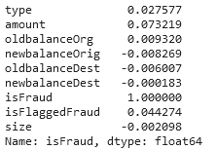
Summary of Analysis
Deleted null and duplicated rows, followed by a correlation analysis.
Ran the correlation regarding fraud.

Slide 5
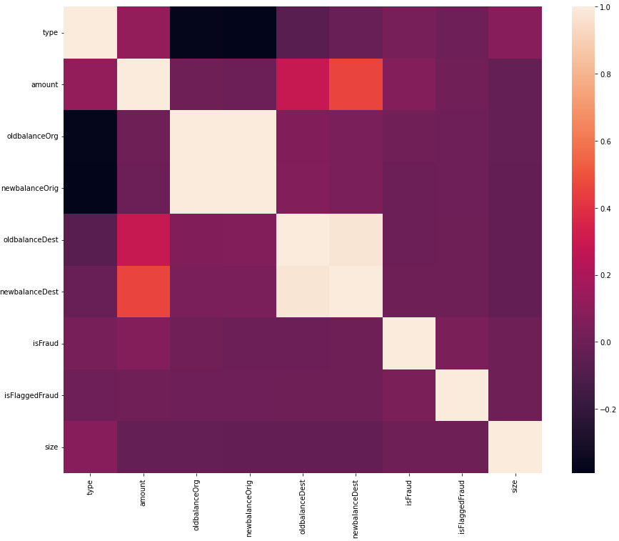
Heatmap Correlation Visualization

Slide 6

Summary of Analysis
Created a sample set from original set using Cochran’s Formula for 99% confidence with 1% margin of error.
16590 samples were selected, another sample set was created as well with remainder
Limitations
Summary set had 53.8% accuracy; regular set had 99.3% accuracy
$n_{0}=\frac{Z^{2}pq}{e^{2}}$

Slide 7
Findings and Proposed action
Using a smaller sample set saves a lot of computation time and space but isn’t very accurate.
Using the full dataset takes up a lot of memory and takes longer to compute, but a lot more accurate
More tests should be done to build a better model for prediction using Logistic Regression, and Decision Trees.

Slide 8
Expected Benefits
Saving over $11.5 billion in fraudulent charges
Company reputation
Better detection tools

Slide 9
Resources
https://www.ftc.gov/news-events/news/press-releases/2022/02/new-data-shows-ftc-received-28-million-fraud-reports-consumers-2021-0 , FTC, 2022
https://towardsdatascience.com/logistic-regression-detailed-overview-46c4da4303bc , Saishruthi Swaminathan, 2018
https://scikit-learn.org/stable/modules/tree.html , Sci-Kit, 2022
https://www.kaggle.com/datasets/rupakroy/online-payments-fraud-detection-dataset , Kaggle, 2022
https://analyticsindiamag.com/why-is-overfitting-so-demonized/#:~:text=%E2%80%9CDue%20to%20overfitting%2C%20a%20model,unseen%20data%20in%20real%20situations , Shraddha Goled, 2021
https://www.tarleton.edu/academicassessment/documents/samplesize.pdf , Glenn D. Israel, 2003
https://www.tdistributiontable.com/ , T-Table, 2021

